Slide 1


Exploring Risk Analytics in Lending Club Finance
Welcome to the intricate world of risk analytics in consumer finance. This presentation delves into the critical task of identifying potential defaulters in loan applications, a significant concern for lending institutions. By examining past data and employing Exploratory Data Analysis (EDA), we aim to uncover patterns that signal the likelihood of loan defaults, enabling lenders to make informed decisions and minimize financial risks.
Mohd Farman
Venkata Kiran Kumar Kudupudi

Slide 2

Understanding the Business Context
1
Loan Application Received
Each loan application triggers a crucial decision-making process based on the applicant's profile, balancing the risk of default against potential business loss.
2
Risk of Non-Approval
Not approving a loan to an applicant who is likely to repay results in a missed opportunity and loss of business.
3
Risk of Approval
Approving a loan to an applicant who may default poses a financial risk to the company, potentially leading to credit loss.

Slide 3
Loan Approval Outcomes
Fully Paid
Current
Charged-off
Applicants who have completely settled their loans, including principal and interest, fall into this positive outcome category.
These are applicants actively repaying their loans. Their tenure is ongoing, and they are not considered defaulters.
Applicants who have failed to make timely payments over an extended period, leading to default on their loan obligations.

Slide 4

Business Objectives and Credit Loss
1
Minimizing Risk
2
Identifying Indicators
3
Strategic Lending
The primary goal is to reduce the number of risky loans, thereby decreasing the potential for credit loss.
Using EDA to identify risky applicants allows for strategic decisions such as loan denial or adjusting loan terms.
Understanding the key indicators of default can help the company in risk assessment and portfolio management.

Slide 5
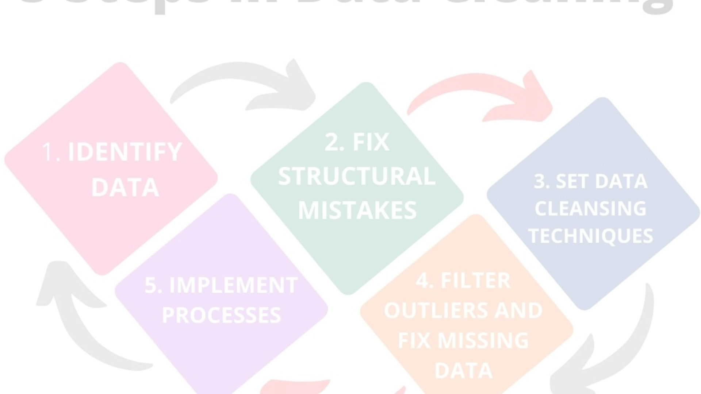
Data Sanitization and Analysis
1
2
3
4
Cleaning Data
Irrelevant Columns
Outliers and Duplicates
Fill missing/ drop unwanted
Columns with more than 50% null values are removed to ensure data quality for analysis.
Columns not useful for decision-making, such as customer behavior variables, columns with only one unique value are discarded.
Outliers that skew data and duplicate rows are identified and corrected to maintain data integrity.
Fill missing values such as inserting 0 if blank bank ruptsy or remove null values for columns

Slide 6
Univariate Analysis Few Insights
Loan Term Preference
Interest Rate Distribution
The majority of loans have a term of 36 months, indicating a preference for shorter loan durations among borrowers.
Interest rates are concentrated around 5-15%, with a notable drop near the 10% mark, suggesting a competitive lending environment.
Loan Grade Analysis
Borrower Demographics
A significant proportion of loans are graded 'A' and 'B', reflecting a high quality of the loan portfolio.
Most borrowers have over 10 years of work experience and reside in major urban areas, indicating a mature customer base.

Slide 7
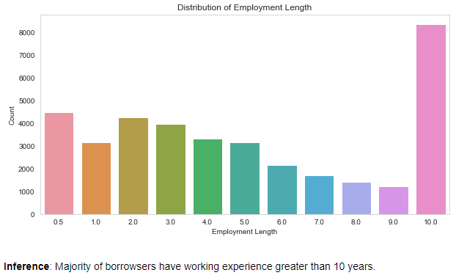
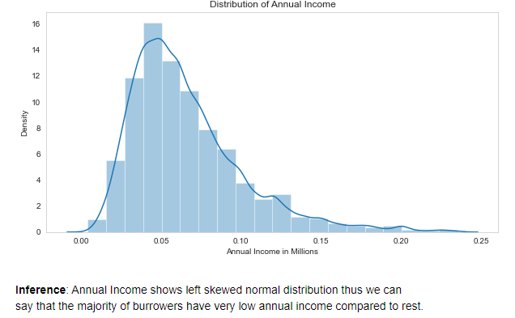
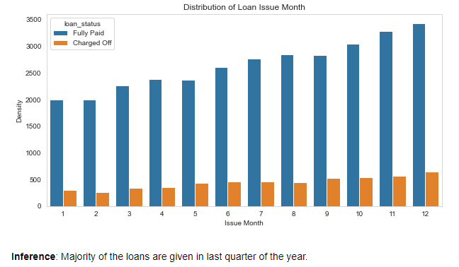
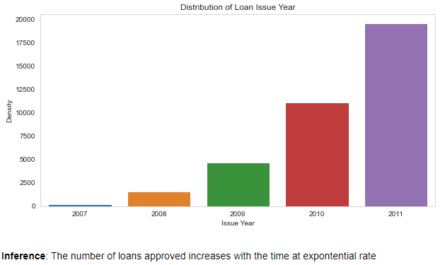
Univariate Analysis Few Insights

Slide 8
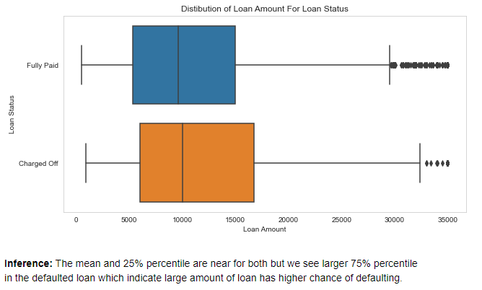
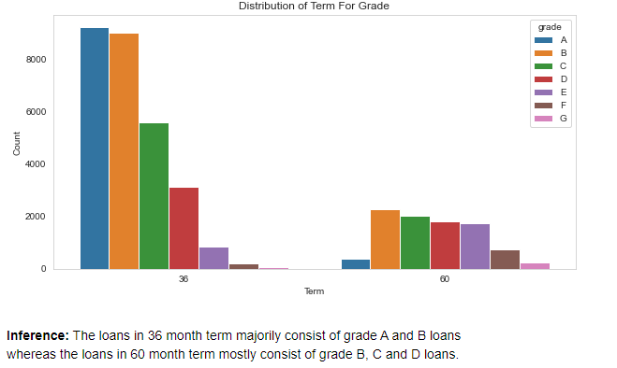
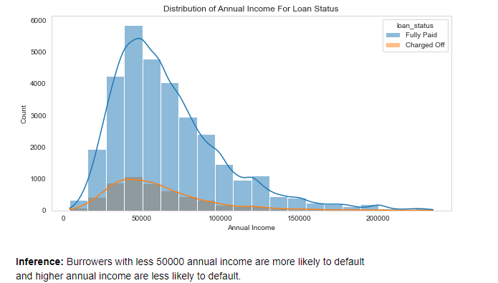
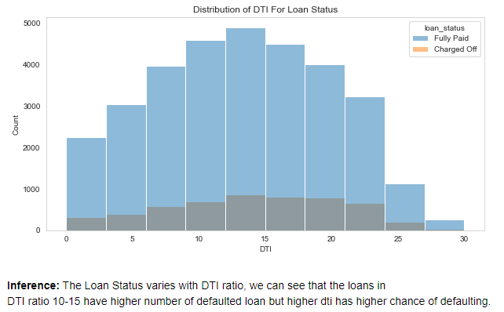
Segmented Univariate Analysis Few Insights

Slide 9
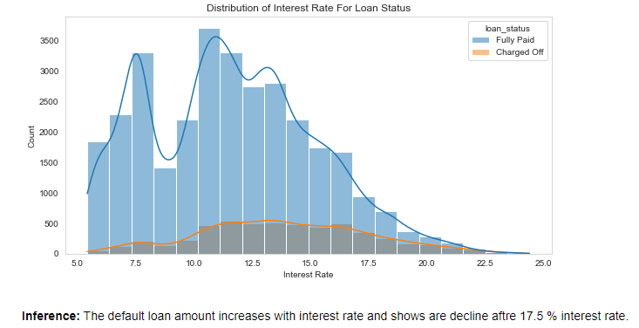
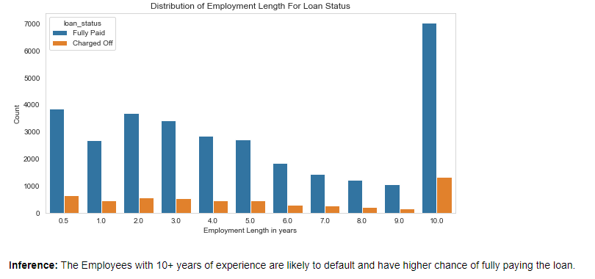
Segmented Univariate Analysis Few Insights

Slide 10
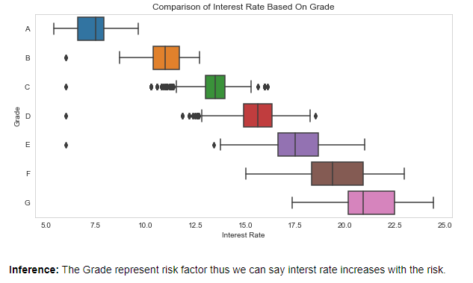
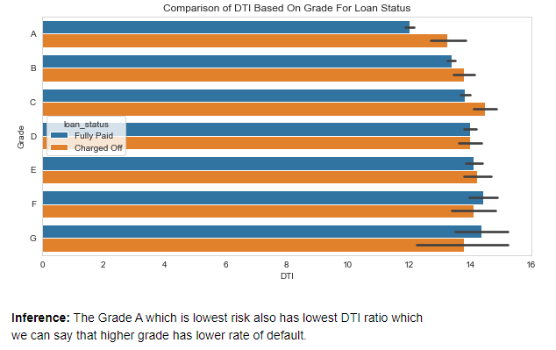
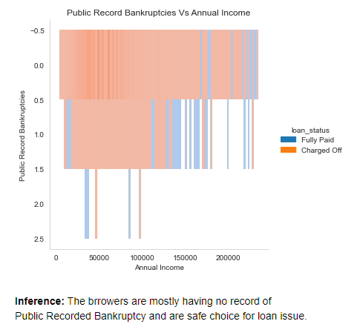
Bivariate Analysis Few Insights

Slide 11
Segmented Univariate and Bivariate Analysis
Loan Purpose
Debt Consolidation
Highest number of defaults
Loan Term vs. Default
60 months
Higher default rate
Grade vs. Interest Rate
Grade A
Lowest interest rates
Annual Income
Less than $50,000
Higher likelihood of default
Public Record Bankruptcy
No records
Safer loan issuance

Slide 12
Conclusions and Recommendations
DTI : Debt-to-Income ratio is a critical predictor of loan default.
Grades : Loan grades correlate with risk levels and default rates.
Income : Annual income levels can influence the likelihood of loan repayment.
Verification : Verification status serves as an indicator of borrower reliability.

